Slide 1
Introducing R
Intro to R Workshop
Trainers – Dr Paul Harrison & Adele Barugahare
Helpers – Dr Sarah Williams & Dr Nick Wong

Slide 2
Today’s Objective(s) – What we hope you will get out of today
Introduction to R
The basics of R – data objects
Data plotting
How to find more information for a specific task
The start of the journey, a network of R learners/users around you.
Entry into more advanced and specialized uses of R for your research.

Slide 3
Why R? (as opposed to Excel?)
It’s free, legally free. Active development.
Reproducible analysis.
Document what you have done with your data in code.
Come back to it in days, months, years and you should know what was done.
Low risk of inadvertent data loss/mutation.
By design, R requires you to load your data in, what you do with the data is then written in code (R language).
R can handle really large datasets.
Excel is limited by 1,048,576 rows and 16,384 columns.
Collaborative.
Share your data and analysis.

Slide 4
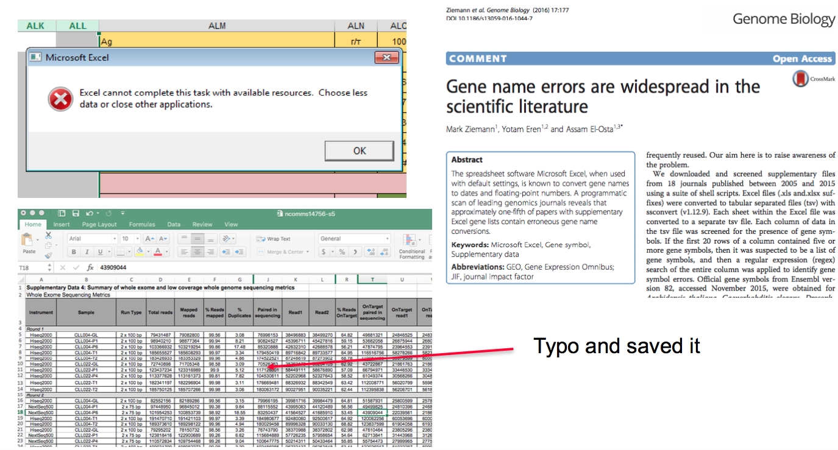
Why R? (as opposed to Excel?)

Slide 5
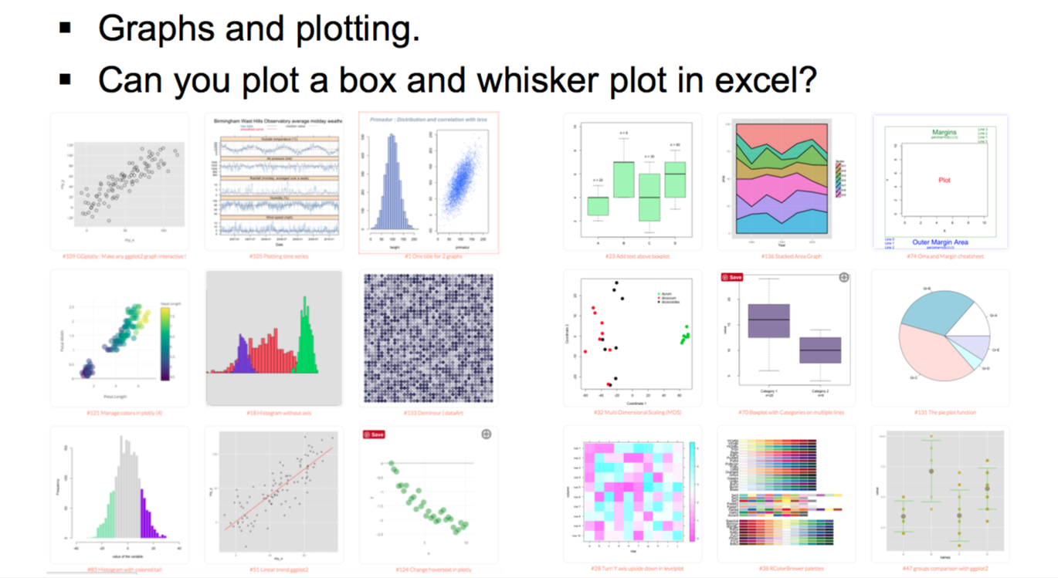
Why R? (as opposed to Excel?)

Slide 6
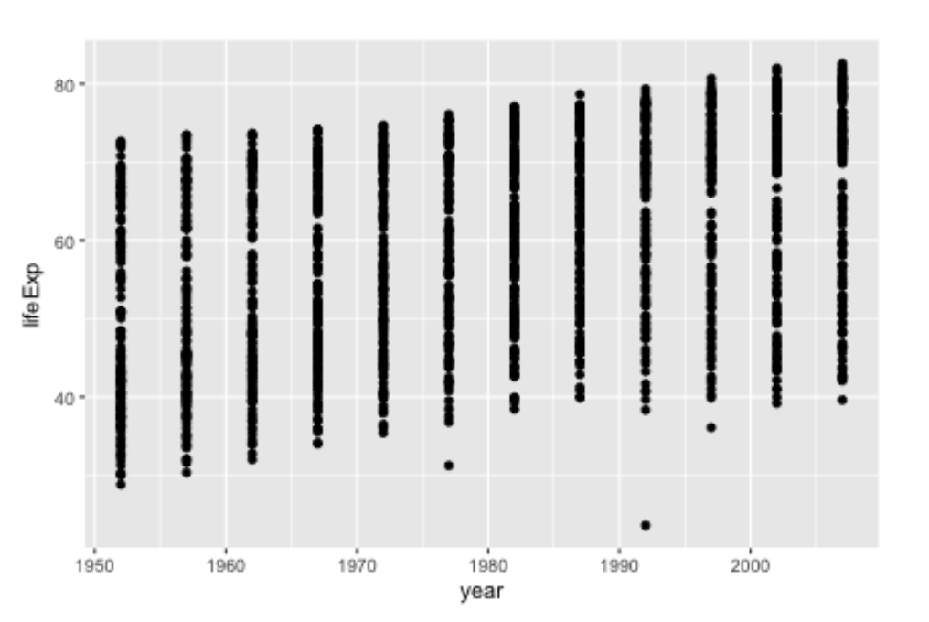
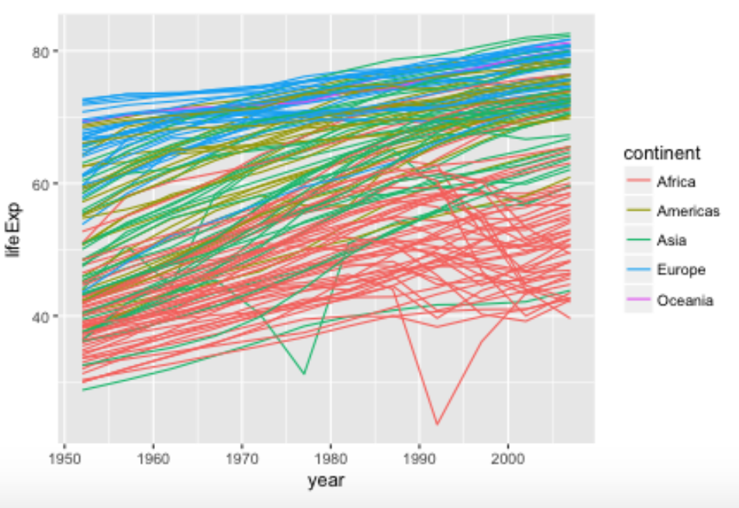
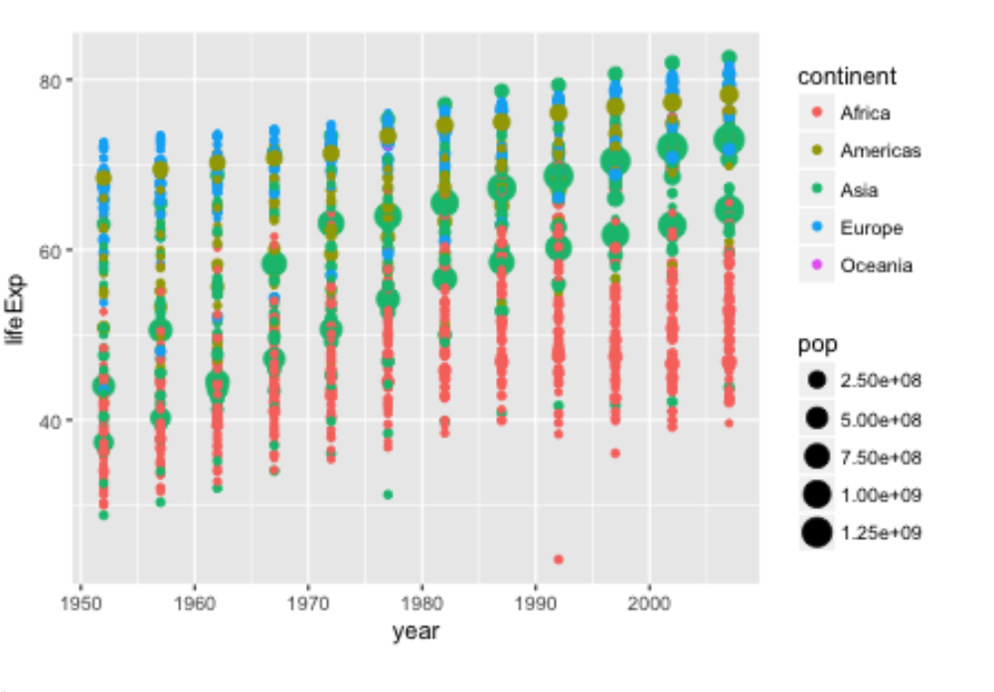
A better way to explore, present and interpret your data….
Learn to encode data
In a graph

Slide 7
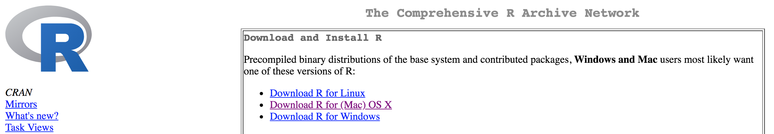
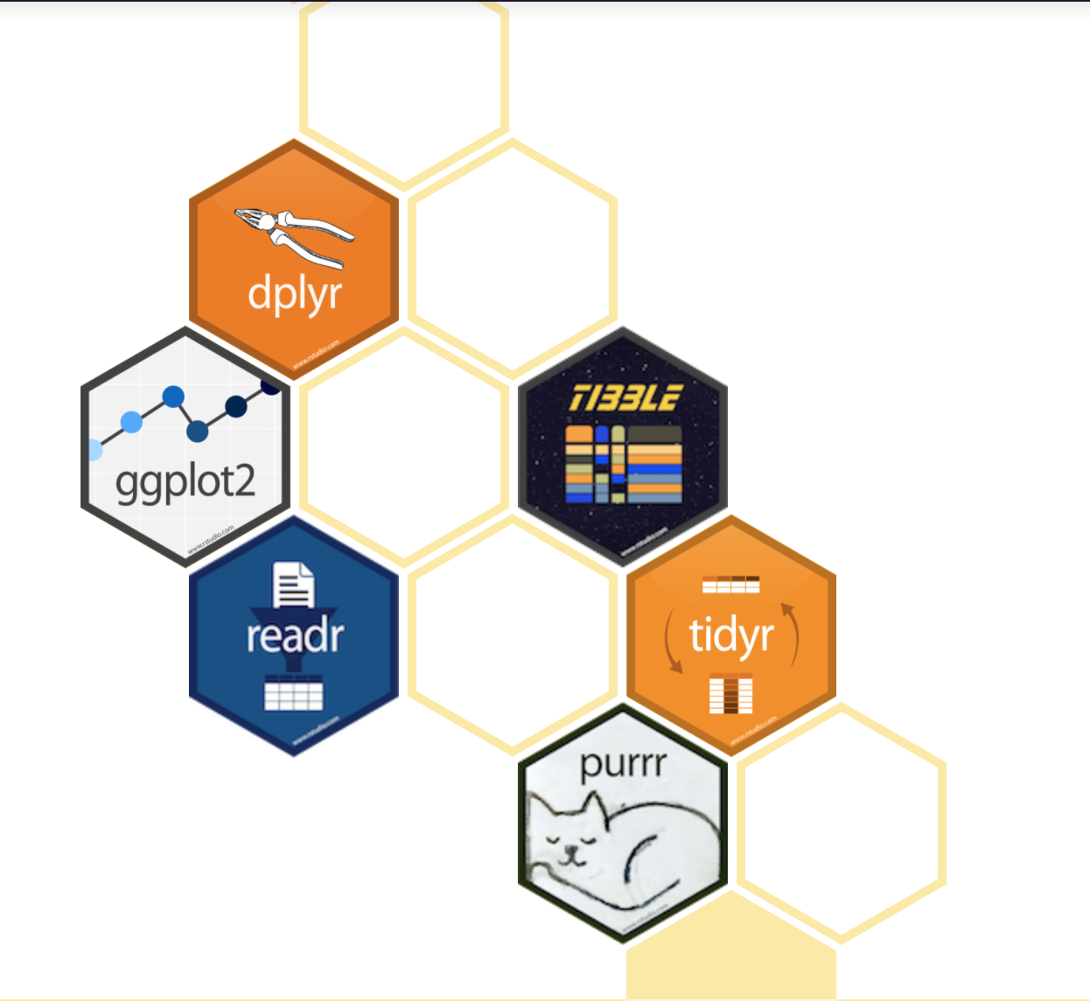
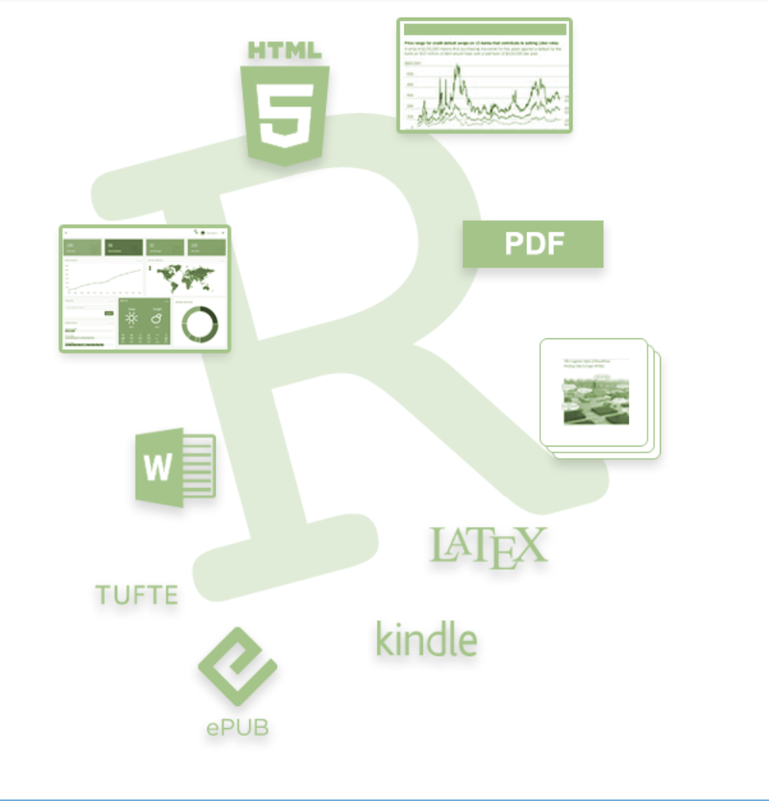

How to get R?
https://cran.r-project.org)
Many specialized tools/libraries for specific purposes
Tidyverse: Data Science
Rmarkdown: Documents
Bioconductor: Bioinformatics

Slide 8
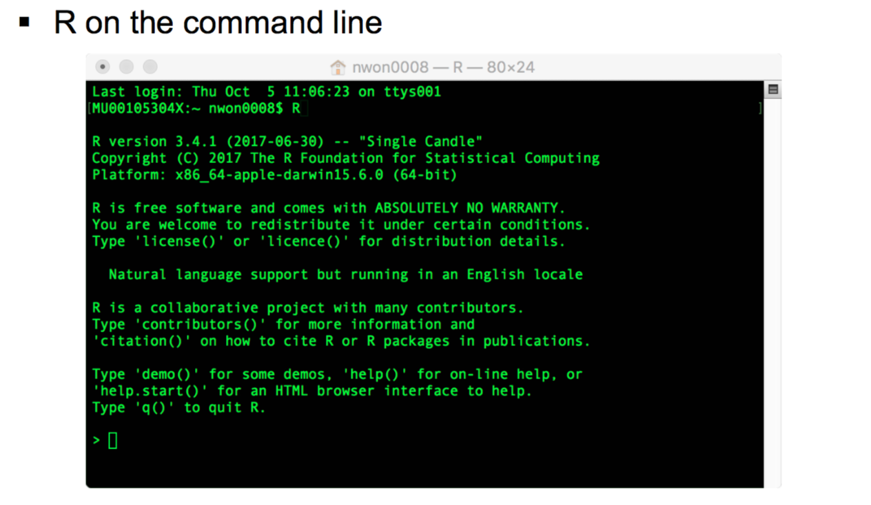
R and the interfaces to R

Slide 9
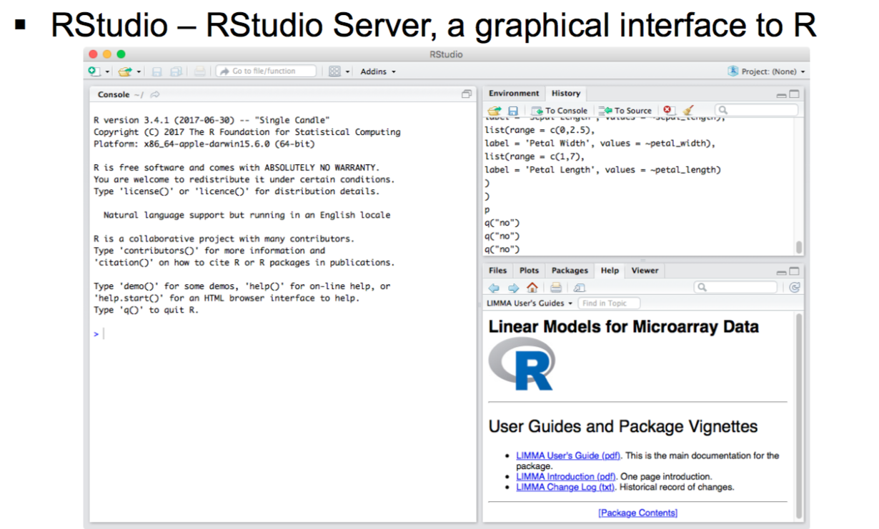
R and the interfaces to R
https://www.rstudio.com

Slide 10
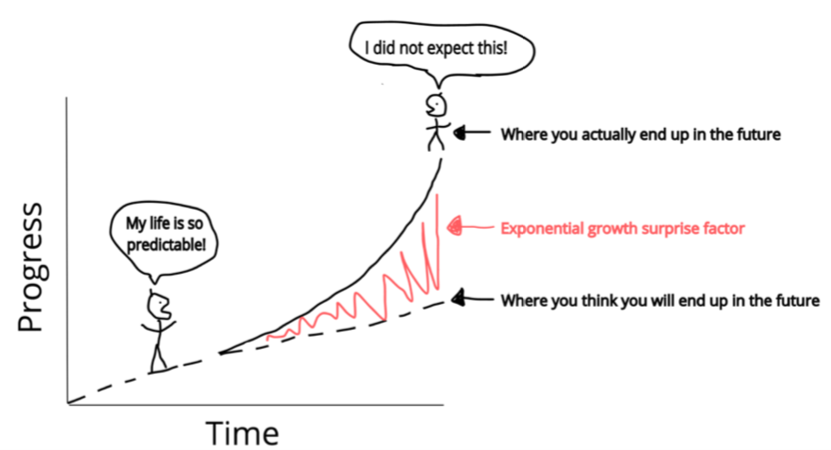
Today’s agenda
Starting out in R
Working with tidy data frames
Plotting with ggplot2

Slide 11

What we won’t be covering but are important in the interest of time.
Things we won’t be covering but are of note:
Base R
Writing your own functions & loops
Statistical modelling (lm, glm……).
Advanced R workshops

Slide 12
How today’s workshop works – signalling for help
Workshop notes
Etherpad
Sticky notes
I need help please
I am all good

Slide 13
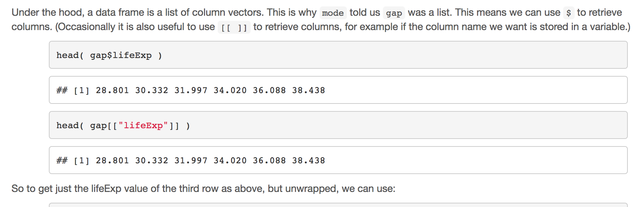
The R workbook
Explanatory text
The code

Slide 14
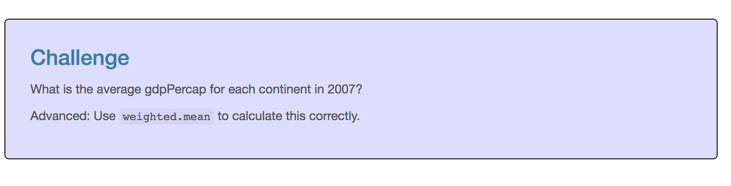
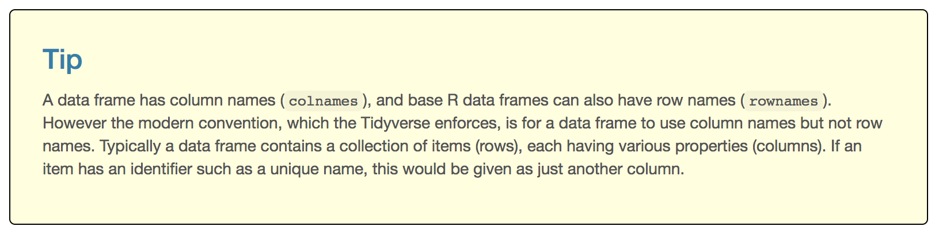
The R workbook – Challenges and tips
We will give you challenges and tips through the workshop to work with the example data

Slide 15
Rounding up
This is the start of your R journey, many others are at the same stage, share your questions.
Attend this workshop again, and others we offer
Advanced R
Specialised use-cases with R (eg: RNASeq)
Friday help sessions at Clayton 3:00pm.

Slide 16
Basic concepts of R and take home messages
R is a programming language and your code can be recorded in an R script file.
Variable
Assignment operator <-
Functions functionName()
Subset [ x , y ]
Run code from R script command/control <enter>
Swap between panes control 1/2

